Slide 1

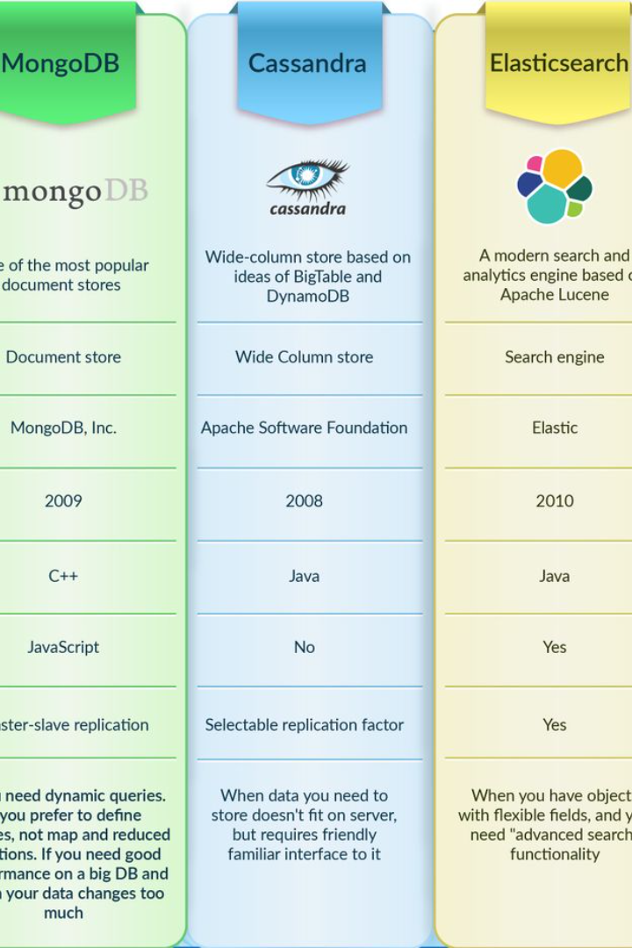

NoSQL vs SQL: A Comprehensive Comparison
Discover the similarities and differences between NoSQL and SQL databases, and gain insights into when to choose each for your data management needs.

Slide 2
NoSQL Databases
1
Introduction to NoSQL
2
Functionality and Use Cases
NoSQL databases provide a flexible and scalable approach to data storage, allowing for rapid development and handling of unstructured or semi-structured data.
NoSQL databases excel in use cases that require high scalability, real-time analytics, and handling of large amounts of complex data, such as social media platforms and IoT applications.

Slide 3

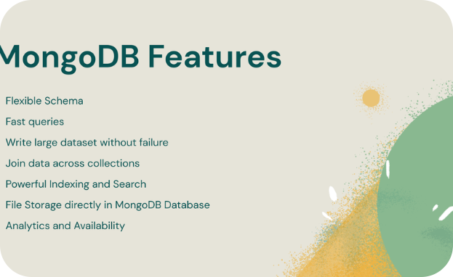
MongoDB: Empowering NoSQL
Introduction to MongoDB
Features and Benefits
MongoDB, a popular NoSQL database, embraces the flexible document data model and offers robust features for developers, including high availability, horizontal scalability, and automatic sharding.
Explore the advantages of MongoDB, such as its JSON-like document structure, easy integration with modern programming languages, powerful querying capabilities with the MongoDB Query Language (MQL), and flexible data modeling.

Slide 4

SQL Databases
1
Introduction to SQL
2
Functionality and Use Cases
SQL databases, also known as relational databases, follow a structured approach for data organization, utilizing tables, columns, and rows for creating relationships between data entities.
SQL databases are ideal for applications with complex relationships among the data, requiring powerful querying capabilities and maintaining data integrity, such as e-commerce platforms and financial systems.

Slide 5

SQL Engines: Powering Relational Databases
1
Relational Database Management Systems (RDBMS)
Features and Benefits
2
RDBMS, like MySQL, PostgreSQL, and Oracle, offer robust SQL query processing, ACID transactions, and strong data consistency, ensuring the reliability and integrity of the stored data.
Discover the features of SQL databases, including data integrity constraints, primary and foreign keys, join operations, and the widely supported SQL querying language, providing a standardized approach to data retrieval and manipulation.

Slide 6

Comparing NoSQL and SQL
Data Modeling and Schema Flexibility
Query Language and Performance
While NoSQL databases offer flexible schema designs, allowing for agile development and accommodating evolving data structures, SQL databases provide stricter schema enforcement for maintaining data consistency.
With NoSQL databases, developers can leverage document-oriented query languages, enabling efficient retrieval of nested data, while SQL databases excel in complex query optimization and handling large datasets.
Scalability and Replication
NoSQL databases offer seamless horizontal scalability, allowing organizations to distribute data across multiple nodes for high performance and low latency, whereas SQL databases provide reliable ACID transactions and strong data consistency.

Slide 7

Conclusion: Making the Right Choice
1
Key Differences
2
Choosing Based on Needs
Summarize the differences between NoSQL and SQL databases, emphasizing their unique characteristics in terms of data modeling, query language, performance, scalability, and consistency.
Highlight the factors to consider when selecting between MongoDB and SQL databases, taking into account specific requirements, project scope, data complexity, and performance expectations.

